Slide 1





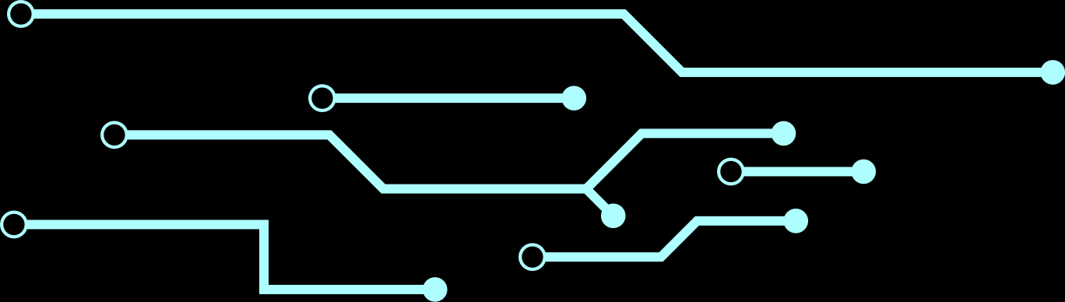
MYTH VS. REALITY: WINDOWS MALWARE ANALYSIS THROUGH GNN AND CFG
Host: Prof. Dr. M M Alam
Guest: Sidra Saleem
Online Available @

Slide 2



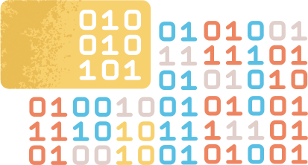
WHY WINDOWS BINARY CLASSIFICATION IS A CHALLENGE WITH GNN AND XAI
CFG's and ACFG's
Windows PE and ELF Binaries
These graph representations can then be utilized as input to GNNs for malware and benign classification tasks, leveraging the power of deep learning to analyze complex relationships within the binary code.
Disassembling Windows Binaries (PE Files ) with tools (disassemblers)
BINARIES
CFG
GNN
GNN Classifier
XAI
XAI
Goal is to find the functions and blocks resposible for the decison of malware and binary tags ,after GNN's decision
GNN as a classifier to make predictions on the graph representations of ASM code.

Slide 3



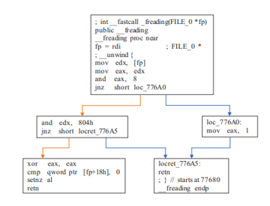
CFG'S AND THEIR NEED
1.
Represent the flow of control within a program or binary.
2.
Breaks down the program into basic blocks and shows the sequence of execution between them.
3.
Aids in identifying loops, conditionals, and function calls in the binary.
serves as the input graph for GNN-based models, allowing GNNs to perform graph-based machine learning tasks on binaries.
4.
5.
CFG will be converted to Adversarial Graphs first

Slide 4
INGREDIENTS OF CFG
Function Calls
Direct Function Calls
Indirect Function Calls
API Calls
Code Blocks
Reccursive Calls
Jump Statements
Return Statements
Data Representation
Function Boundaries

Slide 5
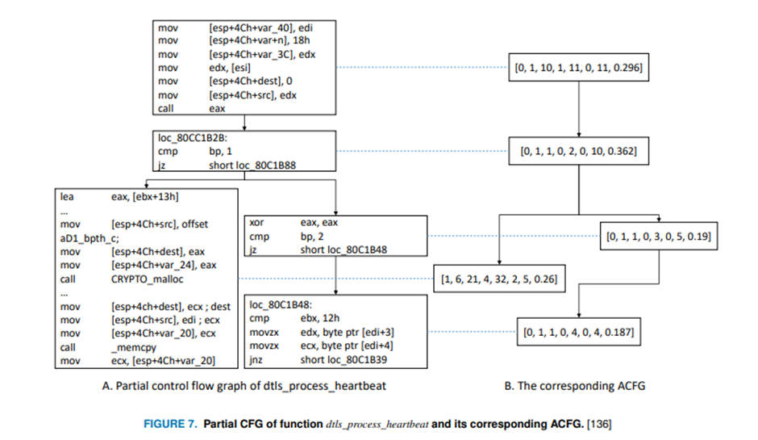
ACFG'S AND THEIR NEED
1.
Extension of CFG specifically designed for malware analysis.
2.
Includes normal control flow paths and potential adversarial paths.
3.
Represents interactions between different parts of the binary
ACFG can also be utilized in eXplainable AI (XAI) methods to provide clearer explanations for the GNN's decision-making process.
4.
5.
ACFG will be converted to Adjacency matric or pyobjects in pickle form

Slide 6
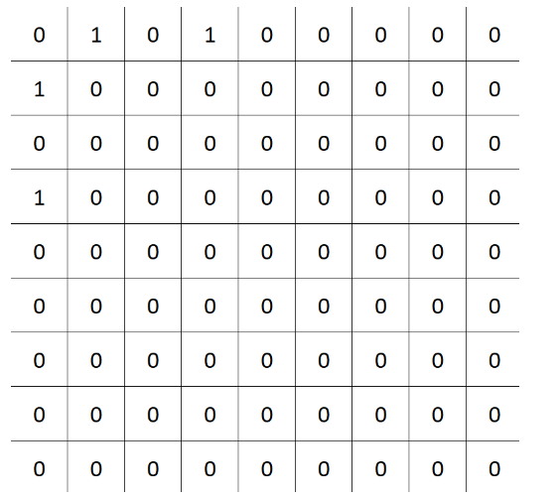
ADJACENCY MATRIX AND THEIR NEED
1.
A square matrix with dimensions equal to the number of extracted features in the ACFG.
2.
Adjacency matrix helps in capturing the overall structure of the ACFG
By representing the ACFG as an adjacency matrix, graph operations can be efficiently performed using matrix manipulation techniques
3.
Adjacency matrix can be utilized in XAI techniques to explain how adversarial edges influence the GNN's decision-making process.
4.
5.
ACFG will be used by GNN for classification

Slide 7

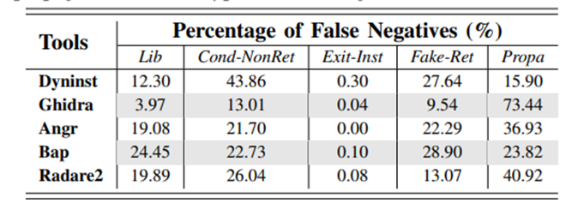
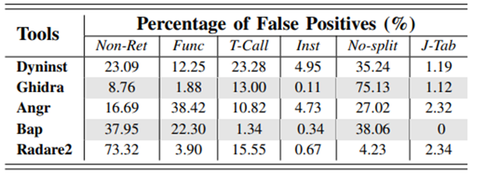
FALSE POSITIVE AND FALSE NEGATIVE IN CFG CREATION
2.
False Negative
False negatives happen when the CFG creation process fails to detect malicious behavior in a program, resulting in the CFG lacking key indicators of adversarial activity.
This can lead to benign programs being incorrectly classified as safe, even though they may contain hidden malware or potentially harmful functionality.
False negatives can compromise the security of the system by allowing malware to go undetected.
1.
False Positives
False positives occur when the CFG creation process mistakenly identifies a benign program as malicious or containing adversarial behavior.
In this case, the CFG may include edges or blocks that are not truly indicative of malicious activities, leading to incorrect classifications.
False positives can affect the reliability of the model and may result in the misclassification of benign programs as malware.

Slide 8
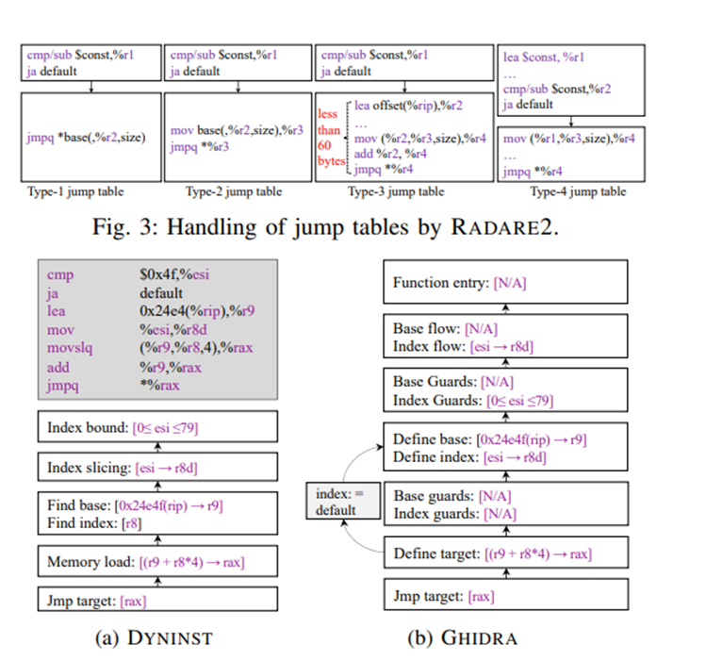

HOW DIFFERENT TOOLS CREATE CFGS AND WHAT WERE THE ISSUES

Slide 9



Tools In Action For CFG Creation
IDA Pro
R2Pipe
Ghidra
THE TOOLS OF BINARY DISASSEMBLY
Keystone
ASM2VEC
PEFile

Slide 10
DIFFERENT DISASSEMBLING TOOLS AND ASM MANIPULATION

Slide 11


STEPS OF BINARY CLASSIFICATION WITH XAI AND GNN
Data Loading
Graph Convolution
01
03
The preprocessed data, which includes the CFGs in the form of adjacency matrices (ACFGs) and their corresponding labels (malware or benign), will be loaded into the GNN model.
The GNN will apply graph convolutional layers to the input ACFGs, allowing information to be exchanged between nodes and their neighboring nodes.
The graph convolution operation helps capture the structural patterns and relationships within the CFGs.
.
Preprocessing
Graph Representation
Feature Aggregation
02
The ACFGs, represented as adjacency matrices, will be used as graph input to the GNN.
Each node in the graph represents a basic block or instruction, while edges represent the control flow relationships between them.
04
The GNN will aggregate features from neighboring nodes, effectively capturing the context and influence of each node within the overall CFG.
This aggregation process helps in learning meaningful representations of the CFGs for classification.

Slide 12
STEPS OF BINARY CLASSIFICATION WITH XAI AND GNN
Non-Linear Activation
05
Non-linear activation functions, such as ReLU (Rectified Linear Unit), will be applied to introduce non-linearity into the model, allowing it to capture complex patterns in the data.
07
Loss Calculation and Optimization
The GNN's prediction will be compared with the ground truth labels using a suitable loss function, such as cross-entropy loss. The model will be optimized using backpropagation and gradient descent techniques to minimize the loss and improve classification accuracy.
Classification
Training and Evaluation
06
The final output of the GNN will be fed into a fully connected layer with softmax activation, enabling the model to make a prediction for each CFG (i.e., classifying it as malware or benign).
08
The GNN will be trained on a training set and validated on a separate validation set to find the best model parameters.

Slide 13
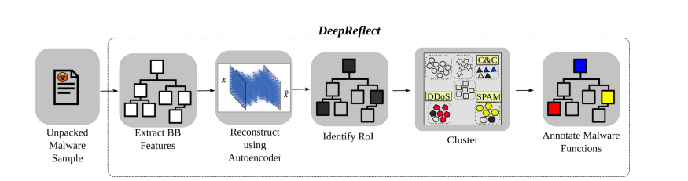
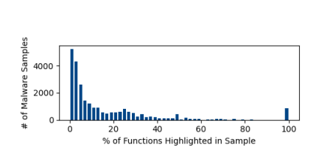
DEEP REFLECT APPROACH
Approach
Results

Slide 14
DEEP REFLECT APPROACH
Unsupervised RoI Detection
1.
DEEPREFLECT uses an unsupervised autoencoder to detect Regions of Interest (RoIs) within a malware binary. These RoIs are likely to contain malicious functionalities, and the autoencoder identifies abnormal regions in the code that deviate from typical benign functionalities.
Annotation with Semi-Supervised Clustering
2.
After detecting the RoIs, DEEPREFLECT performs semi-supervised clustering on the identified functions. It groups the RoIs based on similarities and patterns. Annotations from the analyst's regular workflow are used as labels, and the majority label within a cluster is assigned to the associated malware components.
Localization of Malicious Components
3.
The unsupervised autoencoder provides immediate utility to malware analysts by highlighting the most relevant functions through ranking based on their reconstruction error. It filters out less critical functions, narrowing down the analyst's search space and directing attention to potentially malicious regions.
Focus on Malicious Behavior
4.
DEEPREFLECT's RoI detection and annotation steps enable analysts to quickly locate and understand the malicious behaviors within the malware binary. This automated process reduces the need for manual reverse engineering, making the analyst's workflow more efficient.
Insights into Malware Families
5.
By analyzing and clustering functions with similar behaviors, DEEPREFLECT can provide insights into relationships and trends between different malware families. It helps analysts gain a deeper understanding of the behavior of various malware samples, including variants that might look visually different but share similar malicious logic.

Slide 15
OUR APPROACH
CFGs form ASM
1.
Our technique utilizes Control Flow Graphs (CFGs) as the input representation for malware samples , with IDA Pro and different other tools including Radare, Ghidra ,PEFile Library, Keystone and Capstone as a disassembling tool.
Adjacency Graphs
2.
The CFGs are converted into adjacency matrices to create graph structures.
GNN Application
3.
Graph Neural Networks (GNNs) are applied to the adjacency matrices to learn meaningful representations of the CFGs.
Training
4.
The GNN model is trained using a combination of graph convolution, feature aggregation, non-linear activation, and classification layers.
Optimization
5.
The model is optimized using backpropagation and gradient descent techniques to minimize the loss and improve classification accuracy.
GNN Explainer(XAI Part)
6.
Their approach provides interpretable representations of the CFGs, aiding in understanding the decision-making process and identifying important features.

Slide 16
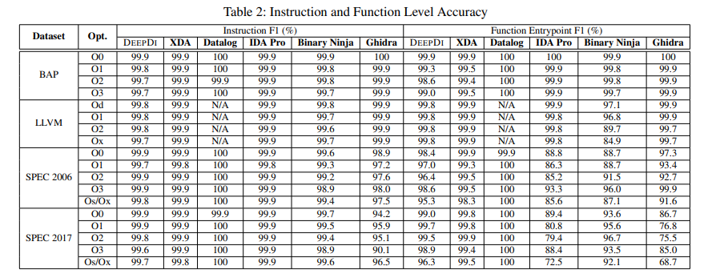
INSTRUCTION AND FUNCTION LEVEL ACCURACY WITH DIFFERENT TOOLS
Instruction-Level Accuracy in CFG Creation:
Function-Level Accuracy in CFG Creation:
Instruction-level accuracy refers to the ability to disassemble machine code and represent CFGs with correct instructions.
IDA Pro and Ghidra are known for their robust disassembly capabilities and achieve high instruction-level accuracy.
Function-level accuracy specifically focuses on how accurately the individual functions in the binary are identified and represented in the CFG.

Slide 17
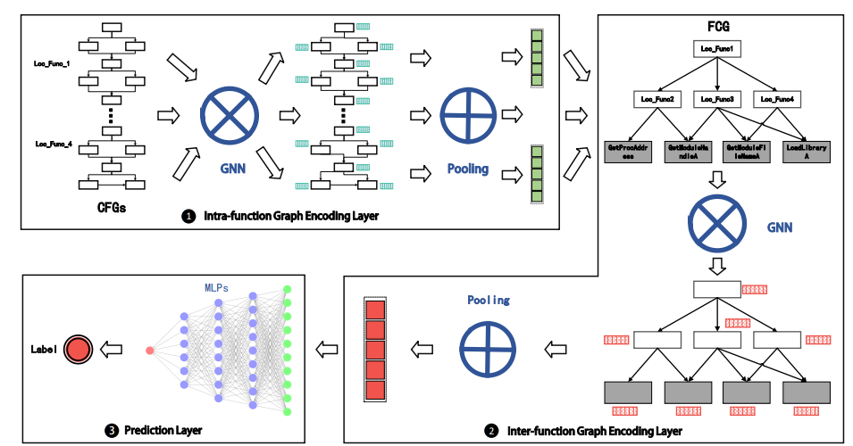
MALGRAPH AND THIER APPROACH IN PREPROCESSING

Slide 18
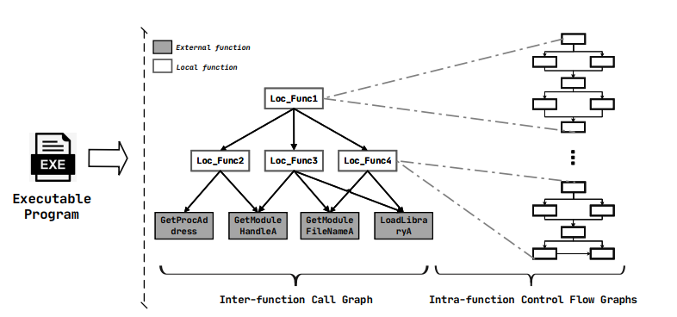
Intrafunctional FCGs(Function Control Graphs) focus on the flow of control within an individual function or subroutine of a program.
The nodes in an Intrafunctional CFG represent basic blocks within the function, and the edges represent the possible flow of control between these basic blocks.
INTERFUNCTIONAL AND INTRAFUNCTIONAL CFGS
Interfunctional (FCG)
Interfunctional CFGs focus on the flow of control between different functions or subroutines in a program.
The nodes in an Interfunctional CFG represent functions, and the edges represent the calling relationships between functions.
Intrafunction CFG

Slide 19

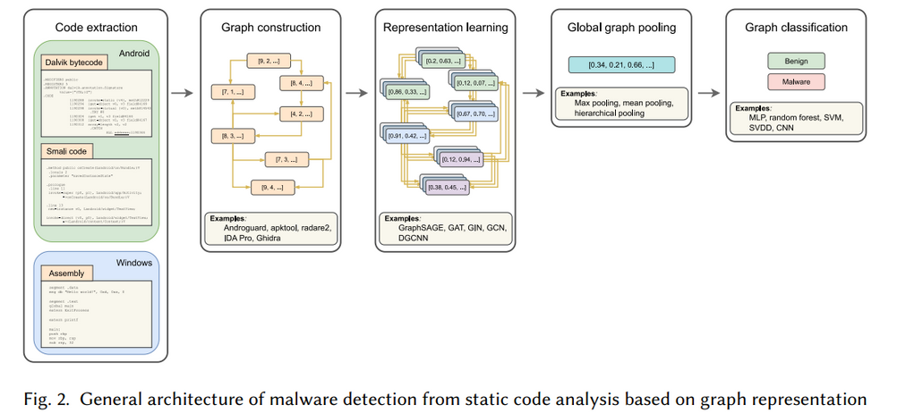

GENERAL ARCHITECTURE OF MALWARE DETECTION FROM STATIC CODE ANALYSIS BASED ON GRAPH REPRESENTATION
01
Code Extraction
The first step is to extract the relevant code from the malware binary or source code files.
Graph Construction
02
Once the code is extracted, a graph representation of the code is constructed.
Each node in the graph typically represents a program element, such as an instruction, function, or basic block, while the edges represent the control flow or data flow relationships between these program elements.
The graph captures the structural and logical relationships within the code.
Representation Learning
03
After constructing the graph representation, the next step is to perform representation learning on the graph.
This involves mapping the nodes and edges of the graph into meaningful feature vectors or embeddings.
Representation learning methods aim to capture relevant patterns and characteristics of the code in a lower-dimensional vector space.
04
Global Graph Pooling
Following representation learning, global graph pooling is applied to aggregate the node embeddings and obtain a fixed-size vector representation of the entire graph.
Global pooling methods summarize the information from all nodes in the graph into a compact representation, which can be useful for making high-level decisions about the graph.
Graph Classification
05
Finally, the graph representation obtained from global graph pooling is used as input to a classification model.
This model can be a traditional machine learning classifier, such as SVM or random forest, or a deep learning model like a graph neural network (GNN).
The classifier analyzes the graph representation and assigns a label indicating whether the code is classified as malware or benign.

Slide 20
CHALLENGES IN CFG RECOVERY
Indirect Jumps and Dynamic Control Flow
Exception Handling and Error Recovery
Indirect jumps and dynamic control flow structures, such as function pointers or virtual function calls, make it challenging to determine the exact control flow path statically.
Resolving these indirect jumps requires sophisticated analysis techniques, including interprocedural analysis and context sensitivity, to accurately construct the CFG.
Exception handling mechanisms and error recovery code introduce non-linear control flow paths that deviate from the regular flow. Exception handling can involve catch blocks, try-catch-finally constructs, or setjmp/longjmp functions.
Recovering the CFG in the presence of exception handling requires specialized analysis techniques to handle these control flow diversions.
Obfuscation and Code Transformations
Lack of Complete Type Information
Malware authors often employ various obfuscation techniques to hide the true control flow and make static analysis more difficult.
These techniques can include code obfuscation, control-flow flattening, or encryption.
Such obfuscation may disrupt the sequential flow of instructions and hinder the accurate recovery of the CFG.
In static analysis, the absence of complete type information can pose challenges for CFG recovery.
In many cases, type inference or type recovery techniques are required to determine the proper type information of variables, function parameters, or return values.
The accuracy of CFG recovery can be compromised if the analysis lacks sufficient type information.

Slide 21





XAI AND THE GOAL
Regulatory Compliance
Transparency
Trust
In some industries, such as healthcare and finance, there are strict regulations about using AI models. XAI can help meet these regulatory requirements by providing justifications for model decisions.
Making AI models more understandable and revealing how they arrive at specific decisions or predictions.
Building trust with end-users, as they can see and verify the reasoning behind AI-driven decisions.
Detection of Bias and Errors
Interpretability
Providing human-interpretable explanations for the model's behavior, helping users understand the key factors influencing the output.
XAI can help identify biases and errors in the AI model, making it easier to rectify and improve the fairness of the system.

Slide 22
RESEARCH POINTS AND FURTHER IMPROVEMENTS
GNN ARCHITECTURE EXPLORATION
INTEGRATE GRAPH EMBEDDINGS
HYPERPARAMETER TUNING
XAI METHODS SELECTION
GRAPH AUGMENTATION
COMPARATIVE XAI ANALYSIS
SEMI-SUPERVISED AND ACTIVE LEARNING
HUMAN-IN-THE-LOOP EXPERIMENTS
HANDLING IMBALANCED DATA
XAI FOR MODEL DEBUGGING
ENSEMBLE TECHNIQUES

Slide 23
REFFERENCES
https://www.usenix.org/system/files/sec21-downing.pdf https://github.com/ryderling/MalGraph https://eecs.ku.edu/exploring-errors-binary-level-cfg-recovery https://cs.stanford.edu/people/jure/pubs/gnnexplainer-neurips19.pdf
https://github.com/extremecoders-re/re-list

